Slide 1
Route finding system
Geospatial Data Management
and Analysis. Principles and
applications
Aurélien Niebes, Bruno Ruiz Juarez and
Rafael Menas Tamasi
Notes:
1

Slide 2
Discipline Objective
Learn geospatial data management.
A practical approach.
2

Slide 3
Why a route finding system?
Backgrounds
Applied Mathematics (Bruno)
Computer Engineering (Rafael)
Electric Engineering (Aurélien)
Experience with Data Bases so we missed the
Geographical part!!!
3

Slide 4
Project Goals
Find if there is a way
Find the fastest way
Solution in reasonable time.
Show it the best way possible
4

Slide 5
Requirements
Get GEODATA!
Define a good enough network
Show it the best way possible!
5

Slide 6
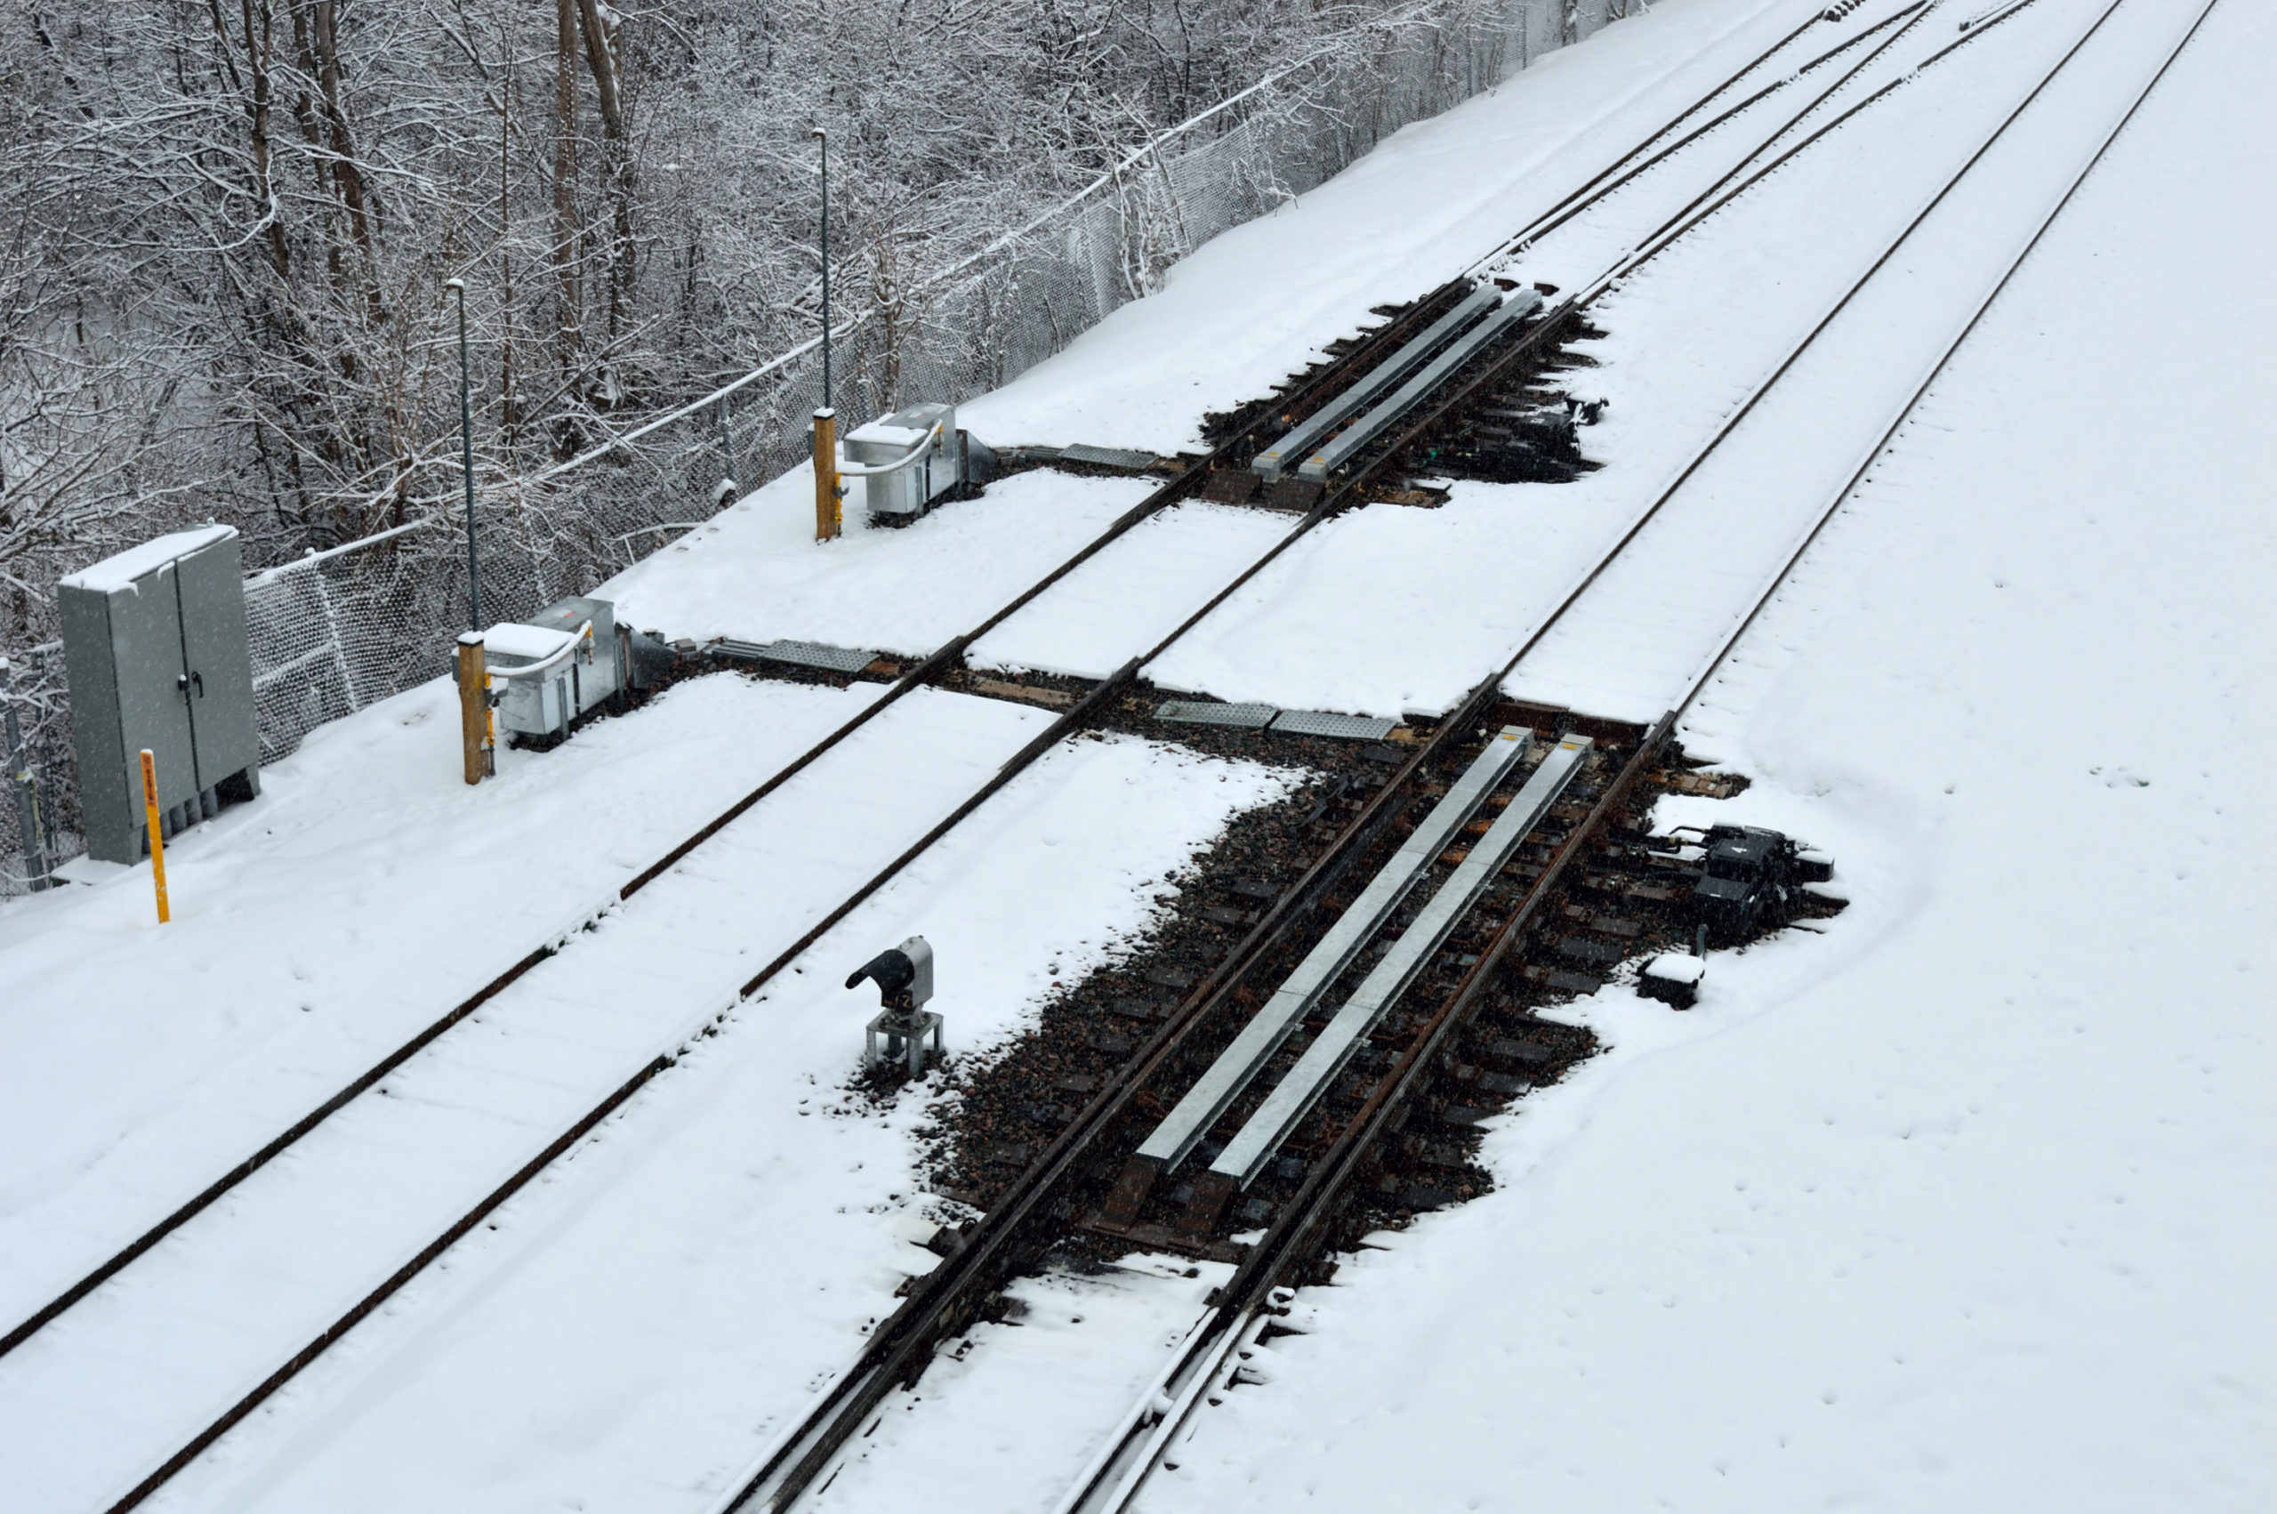
What is Geodata?
Geodata
Geodata is spatial data tied to geographic locations.
Well level sensors
Switch Heaters
6

Slide 7
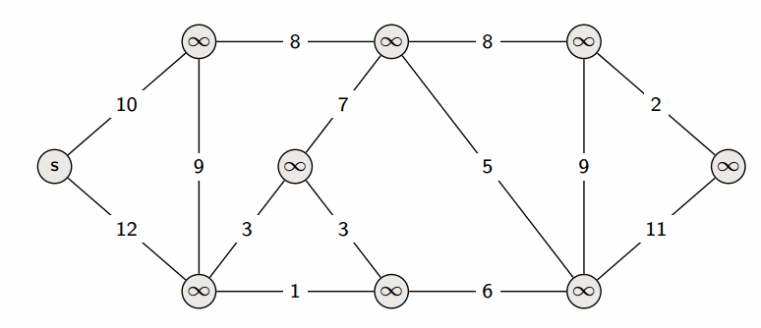
Essential concepts
Dijkstra’s Algorithm
Algorithm created to solve transport problems (Graph Theory)
7

Slide 8
Essential concepts
The algorithm is the following :
Initialize all nodes with infinity (∞) distance except the source node (0).
Visit unvisited nodes with the smallest distance.
Relax neighbors by updating tentative distances.
Repeat until all nodes are visited.
8

Slide 9
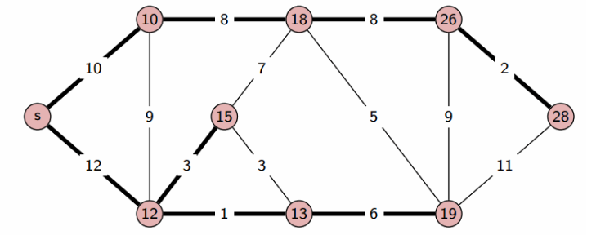
Essential concepts
It's easier than sounds
9

Slide 10
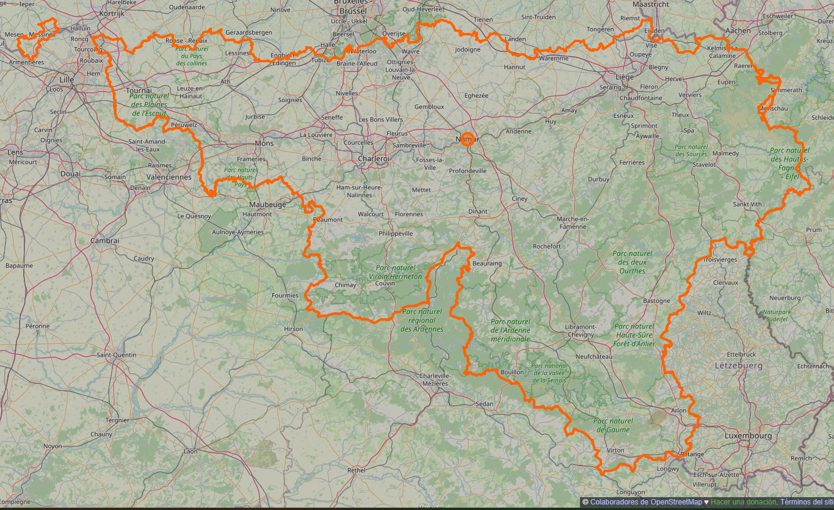
OK, but how we get the network?
Open street map & BBBike Open streetmap page
A free, collaborative map of the world.
A tool for cycling routes and geodata extraction.
10

Slide 11
Python tools
Libraries:
Osmnx:
Simplifies OpenStreetMap data retrieval and graph creation.
Folium:
Creates interactive maps for dynamic route visualization.
Netowrkx:
Performs graph-based analysis and implements Dijkstra’s algorithm.
GeoPandas:
Handles geospatial data and integrates GTFS files.
11

Slide 12
System Architecture
Data Collection
Walking paths were extracted from OSM using osmnx
GTFS files provided bus stop location and schedules loaded with Pandas and processed using GeoPandas
The GTFS file are from TEC, the bus network operator in Wallonia
12

Slide 13
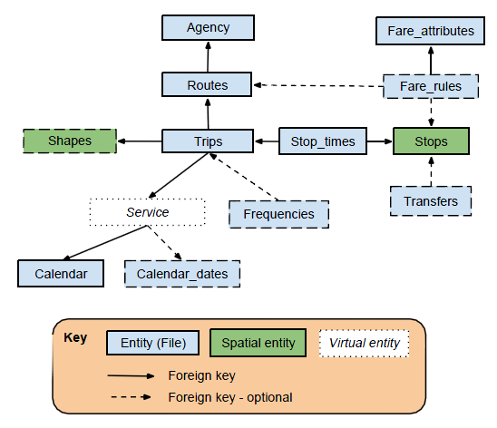
System Architecture
Introduction
Discipline Objective
Why a route finding system
Project goal and Key features
Essential concepts
Route optimizations tools
Dijkstra's Algorithm
Leveraging Open-Source Libraries
System Architecture
Data Collection
Data filtering
Graph construction and Shortest path calculation
Visualization
Results
Discussion
Conclusion
Data Collection: GTFS files
https://medium.com/analytics-vidhya/the-hitchhikers-guide-to-gtfs-with-python-e9790090952a
13

Slide 14
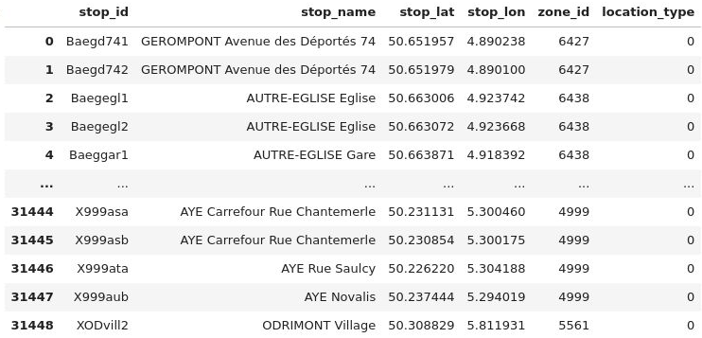
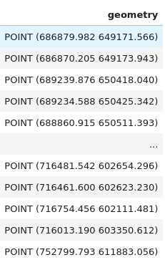
System Architecture
Data Collection
GTFS file: stops.txt: Bus stops
From coordinates to points
14

Slide 15
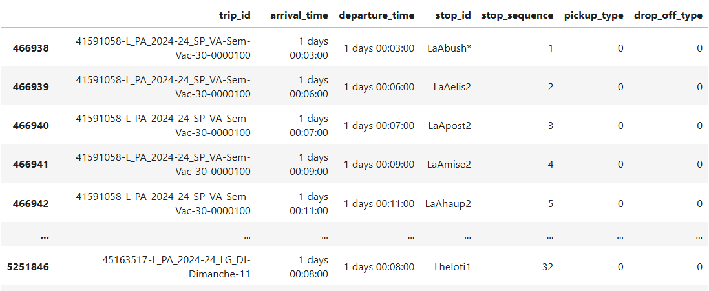
System Architecture
Data Collection
GTFS file: stoptimes.txt: Schedule of the buses
15

Slide 16
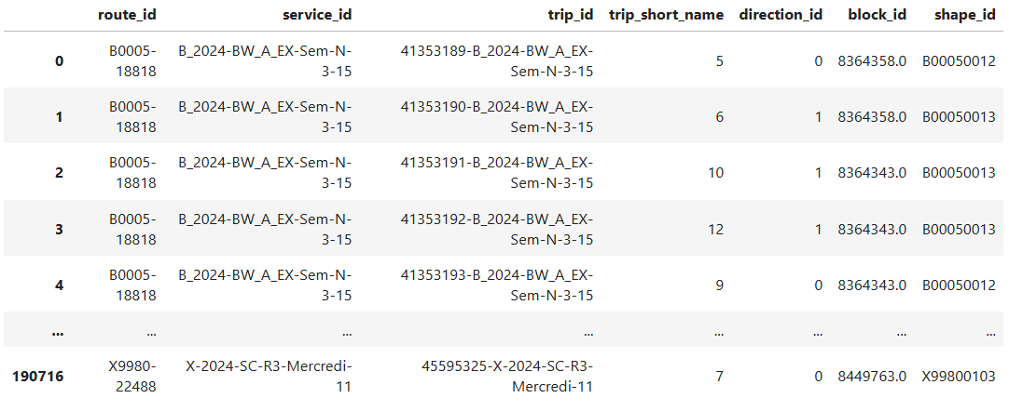
System Architecture
Data Collection
GTFS file: trips.txt: Bus trips active on given days
16

Slide 17
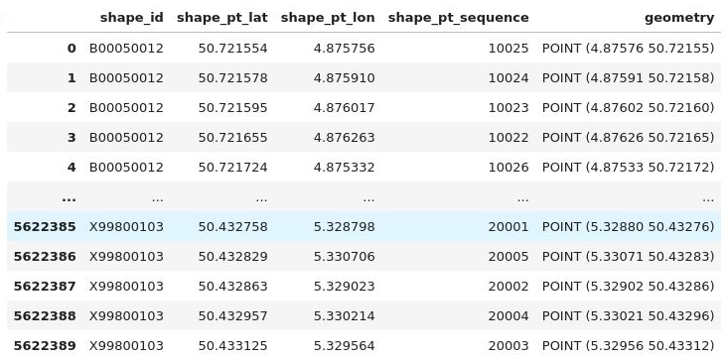
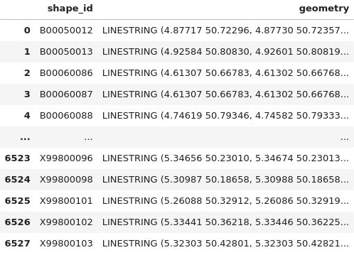
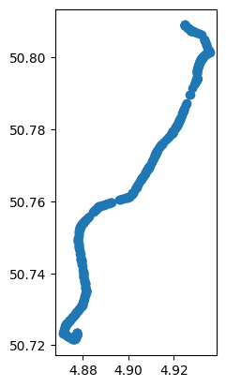
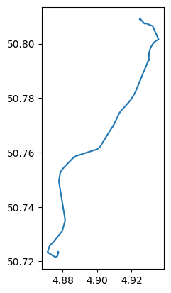
System Architecture
Data Collection
GTFS file: shapes.txt: Roads followed by the buses
17

Slide 18
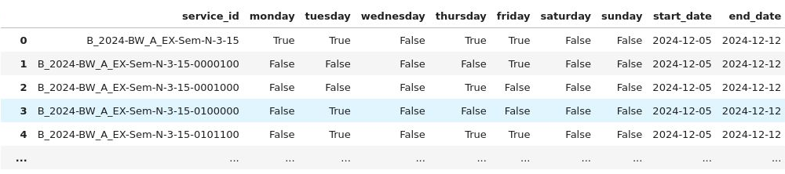
System Architecture
Data Filtering
Bus stops were filtered to those within a 3km radius of the starting location using geospatial buffers in GeoPandas.
This ensures only relevant stops are included, reducing computational complexity.
Identification of active bus trips​
The active bus schedules are identified by the active "services" in the GTFS files ​
The active services depend on the date and the day of the week (We ignore the exception like Christmas Eve)
18

Slide 19
System Architecture
Route calculation (A Dijkstra variant)
The bus network is constructed as it is explored. We explore the bus stops one at a time, i.e: find all the bus stop connected to it by bus trips or by walking
The bus stops closest to the arrival point are explored first
The explored bus stops are marked as "explored"
Duplicated bus stops
If there exist several ways to go to a bus stop, only the earliest arrival time is kept
19

Slide 20
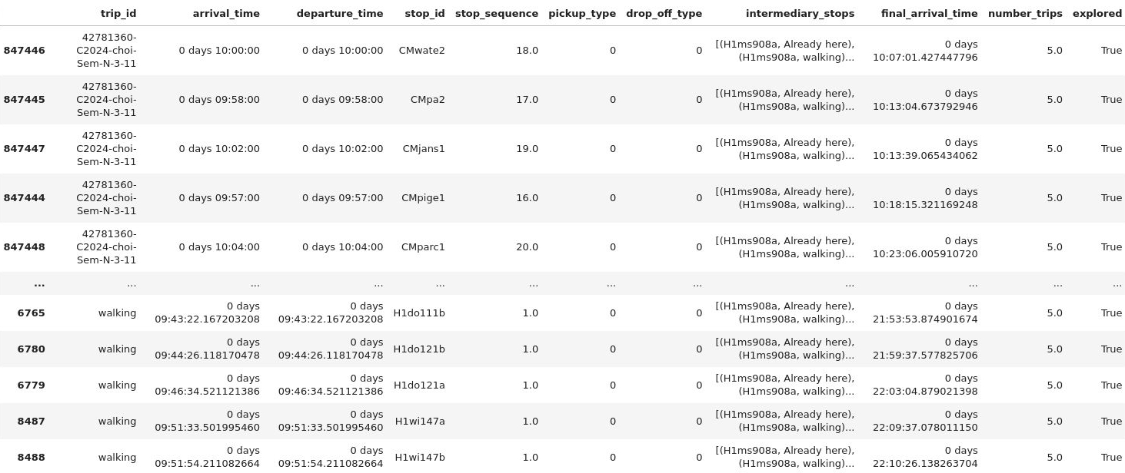
System Architecture
Maximum transfers
The intermediary stops to go to bus stops are stored
If there are too many transfers, the bus stops is automatically marked as explored
Found bus stops
20

Slide 21
System Architecture
Graph Construction
Used osmnx to generate a walking network graph centered on Mons, Belgium.
The graph represents nodes (intersections) and edges (roads or paths) for efficient analysis.
Shortest Path Calculation
The shortest path between two bus stops are computed dynamically using NetworkX shortest_path function.
Path lengths are calculated based on edge weights (distance).
21

Slide 22
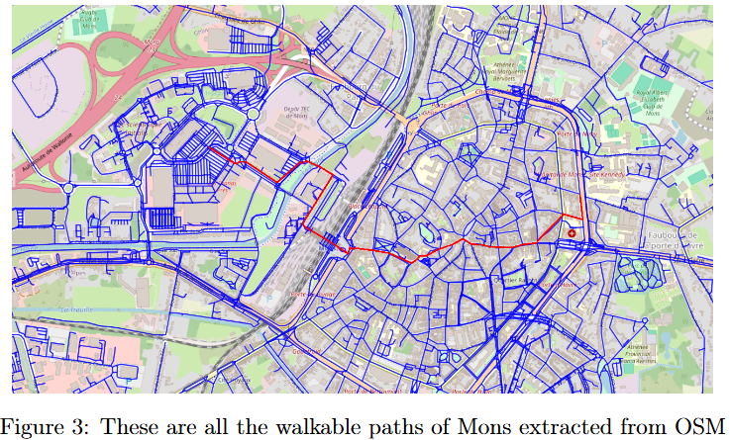
System Architecture
Graph Construction
22

Slide 23
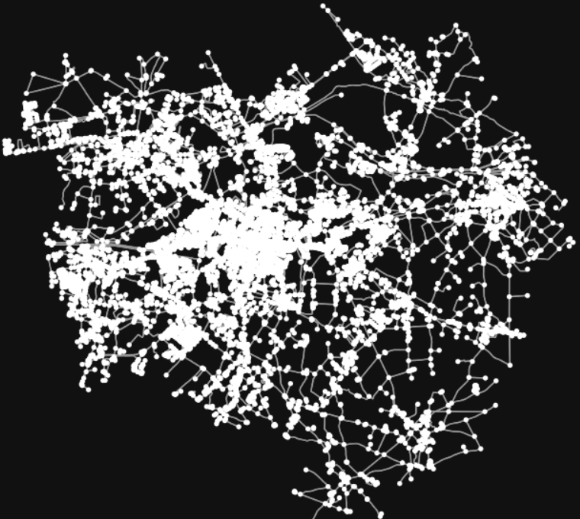
System Architecture
Graph Construction
23

Slide 24
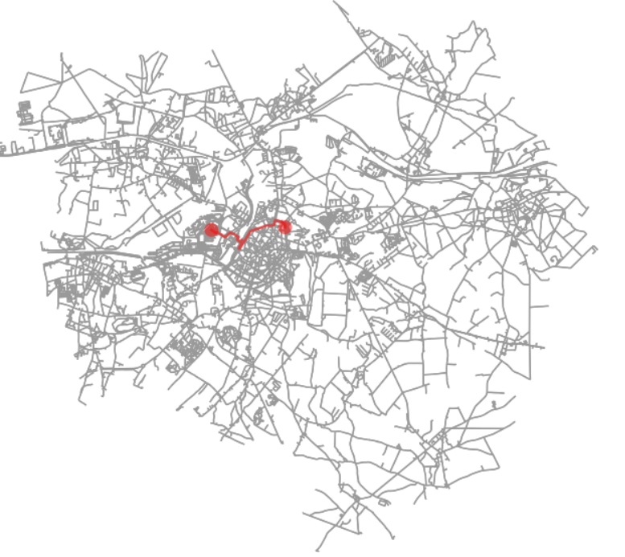
System Architecture
Shortest Path Calculation
24

Slide 25
System Architecture
Visualization
Interactive maps were created using folium, displaying the walking paths and bus stops.
Generated a GeoDataFrame combining paths, stops, and the start point for detailed spatial analysis and visualization.
25

Slide 26
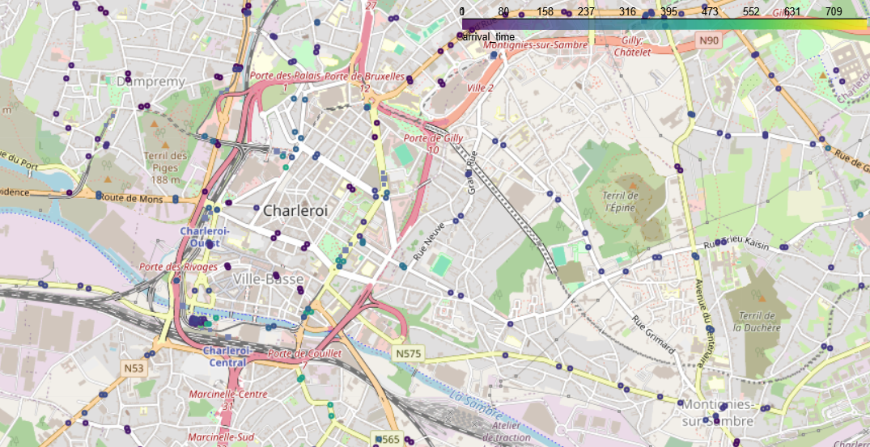
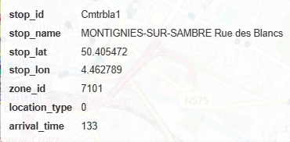
System Architecture
Visualization
26

Slide 27
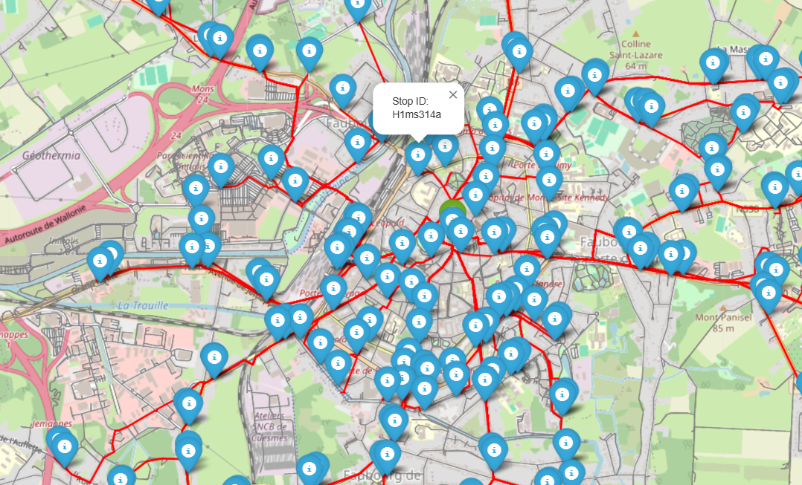
System Architecture
Visualization
27

Slide 28
Results
Isochrone Analysis
Generated isochrone maps using walking speed and distance to show accessibility zones.
Indetifying bus stops withing practical walking distances.
Interactive Maps
Visualized paths and bus stops dynamically using folium.
Maps include detailed route overlays and markers for stops, enhancing user interaction.
28

Slide 29
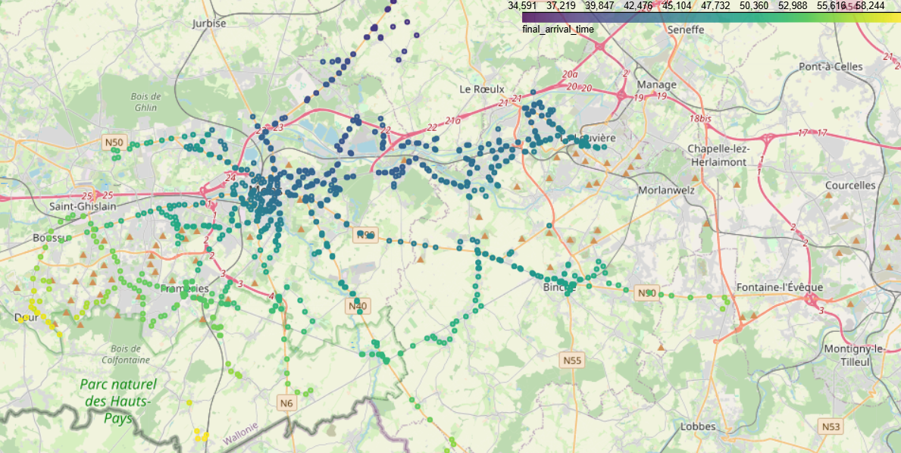
Results
Isochrone Analysis
29

Slide 30
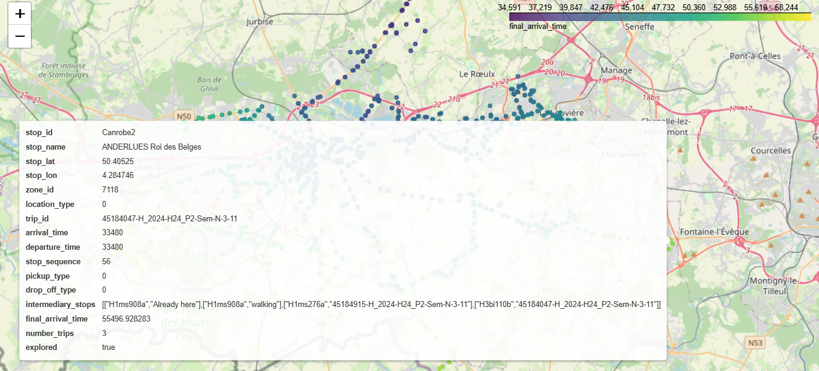
Results
Isochrone Analysis
30

Slide 31
Results
Shortest Paths
Dijkstra’s algorithm.
Routes were optimized for both walking distances and bus schedules
Performance
Routes were computed efficiently even with a large dataset.
e.g: ~1 minutes and 30 seconds for Mons-Soignies
31

Slide 32
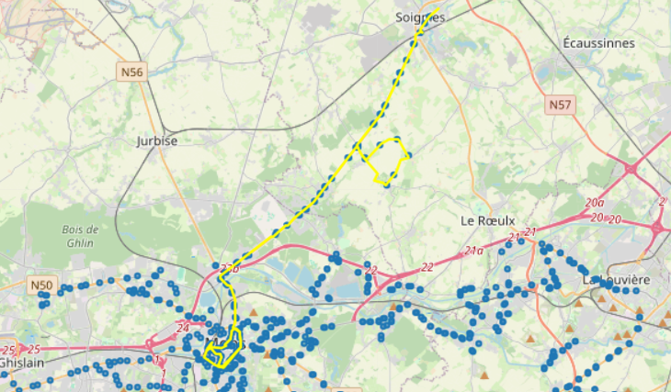
Results
Best Path
32

Slide 33
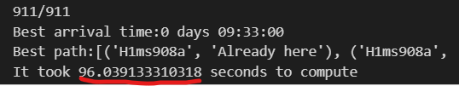
Results
Performance
33

Slide 34

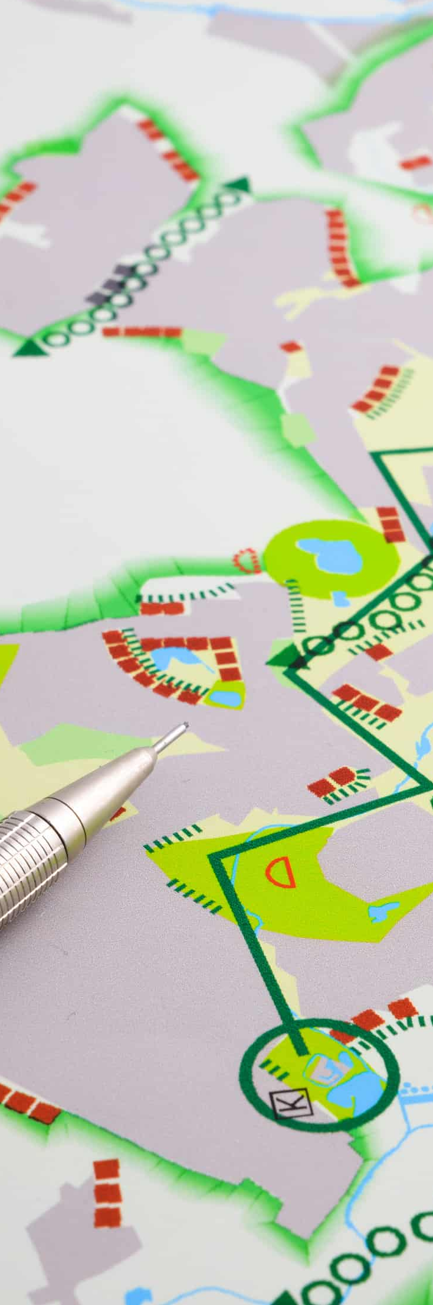
Discussion
Strenghts
Comprehensive route analysis with isochrone maps and dynamic visualizations.
Combines open-source tools and algorithms.
Useful for urban planning, disaster response, and public transit optimization.
Challenges
Performance limitations to dense graphs.
Exceptions in bus schedules.
Geographic accuracy of bus stops.
Consider routes with multiple buses included quickly.
34

Slide 35
Discussion
Future Improvements
Speed algorithm improvements.
Real time data integration.
Expanding to multi-modal transport systems (e.g., trains, cars).
User interface.
35
Notes:
Optimization: Deleting the bus stops from where it takes too much time by bus even in bird-fly.
35
35
35
35

Slide 36
Conclusion
Introduction
Discipline Objective
Why a route finding system
Project goal and Key features
Essential concepts
Route optimizations tools
Dijkstra's Algorithm
Leveraging Open-Source Libraries
System Architecture
Data Collection
Data filtering
Graph construction and Shortest path calculation
Visualization
Results
Discussion
Conclusion
Project Achievements
Developed a Python-based tool for route optimization using walking and bus paths.
Functional project.
Key Outcomes
Validated the effectiveness of Dijkstra’s algorithm and isochrone maps for geospatial analysis.
The group learned the basics of how to use geoprocessing tools.
36

